Slide 1
ISO 20121:2024
Resources to support you to use your voice to champion the creation of a sustainable event sector.

Slide 2
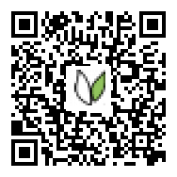
I am a Positive Impact Ambassador
Notes:
As one of over 2,000 global Positive Impact Ambassadors from over 60 countries I regularly receive powerpoints from the Positive Impact team which I can use to share insight with the aim of advancing sustainability in the event sector

Slide 3
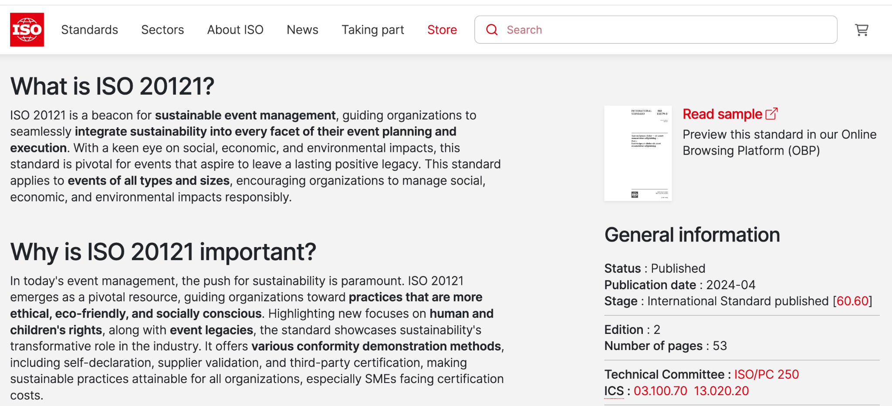
Notes:
On Wednesday 3rd April the revision of ISO 20121:2024 launched.
What is ISO 20121? It is a framework to follow so that sustainability is considered at every decision point in your event.
Lets watch a short animation to learn more

Slide 5
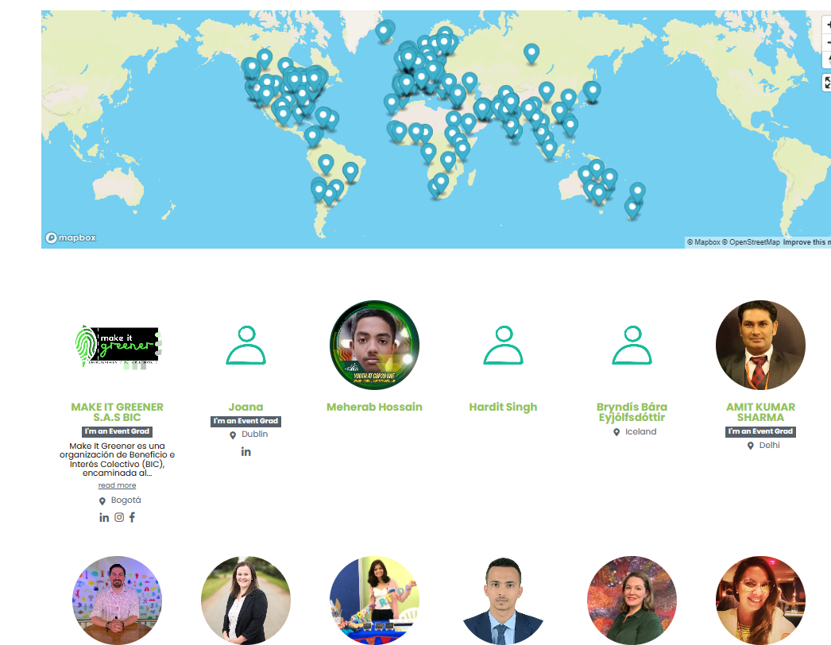
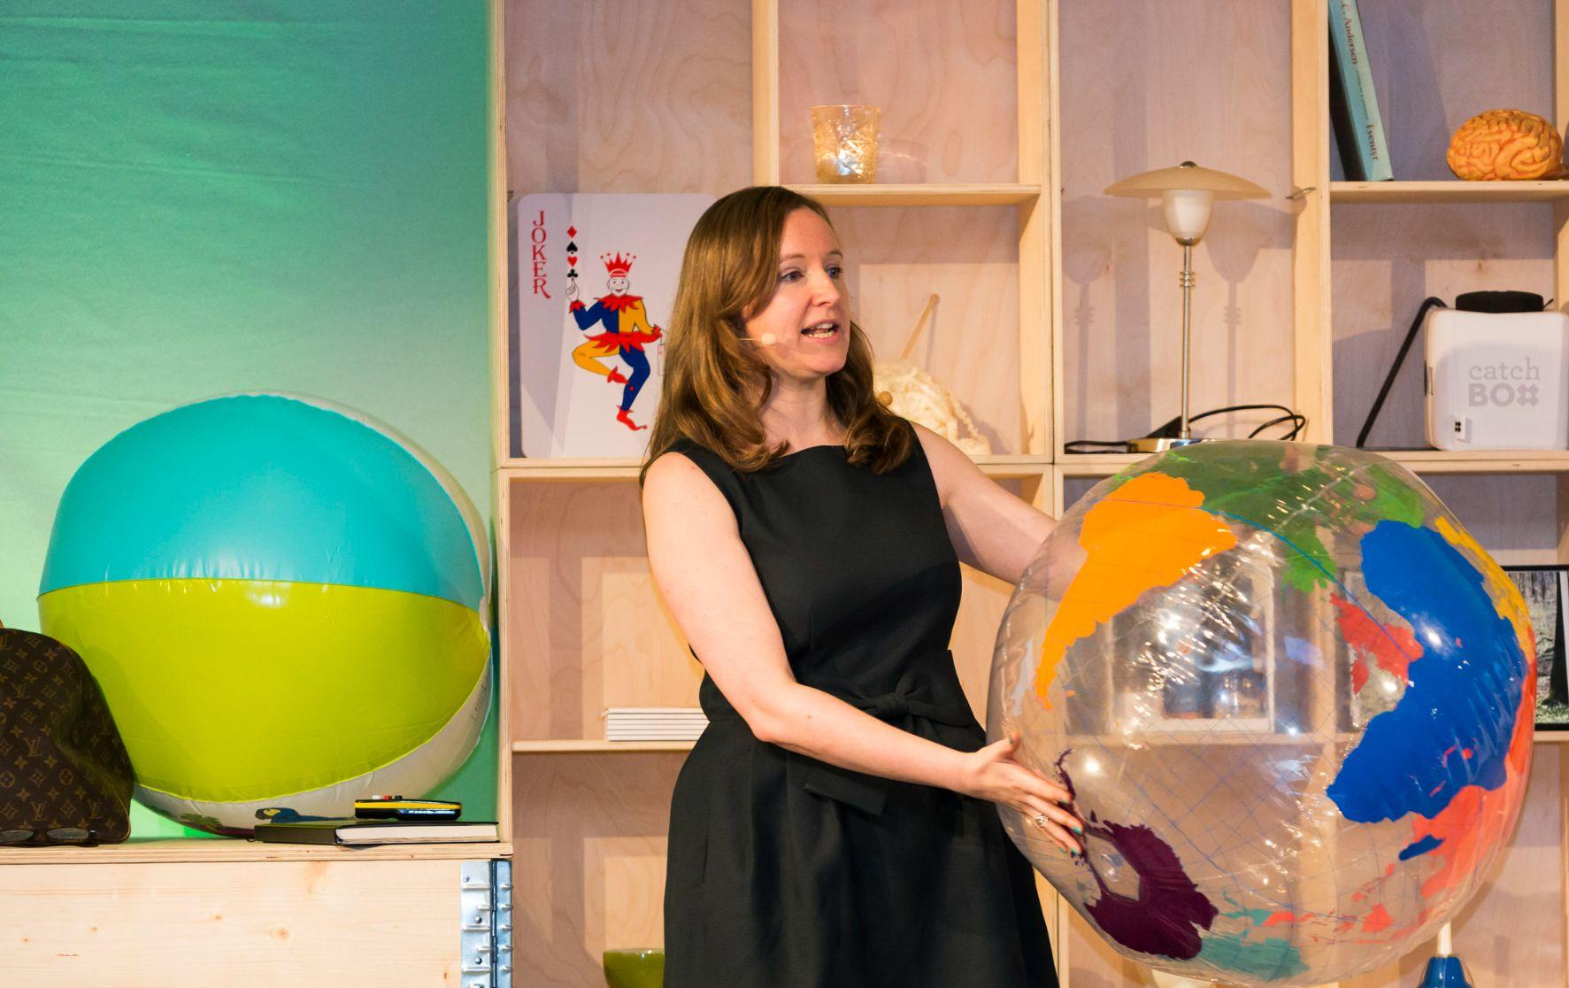
Positive Impact CEO - Fiona Pelham
Notes:
As a Positive Impact Ambassador I receive regular resources so I can use my voice to advance sustainability within the event sector.
While I am not an ISO 20121 expert I can share some great information with you today because the Positive Impact community have been involved in the revision process.
For example Positive Impact CEO chaired the project committee for the revision and the global Positive Impact community received resources to be able to give input via national standard bodies and liaisons

Slide 6
Notes:
ISO 20121:2024 has increased focus on: Climate Change, Human Rights, Legacy
What is different with the revision of ISO 20121:2024? There is an increased focus on climate change, human rights and legacy.
ISO have net zero guidelines, a collaboration with the Race to Zero and all ISO standards are having an increased focus on climate change
ISO 20121:2024 includes a guidance annex on considering human and child rights when planning and delivering an event which was co written by Unicef UK and Positive Impact ISO 20121:2024 references legacy in new ways for example the sustainability policy should now include a commitment to assess and report on achievements, lessons learnt and where appropriate wider outcomes.
Lets watch 3 short animations to bring these areas of focus to life

Slide 7
Notes:
The Race to Zero 5th P

Slide 8
Notes:
Understanding Human Rights

Slide 9
Notes:
How to imagine the future of the event industry accelerating the Sustainable Development Goals

Slide 10
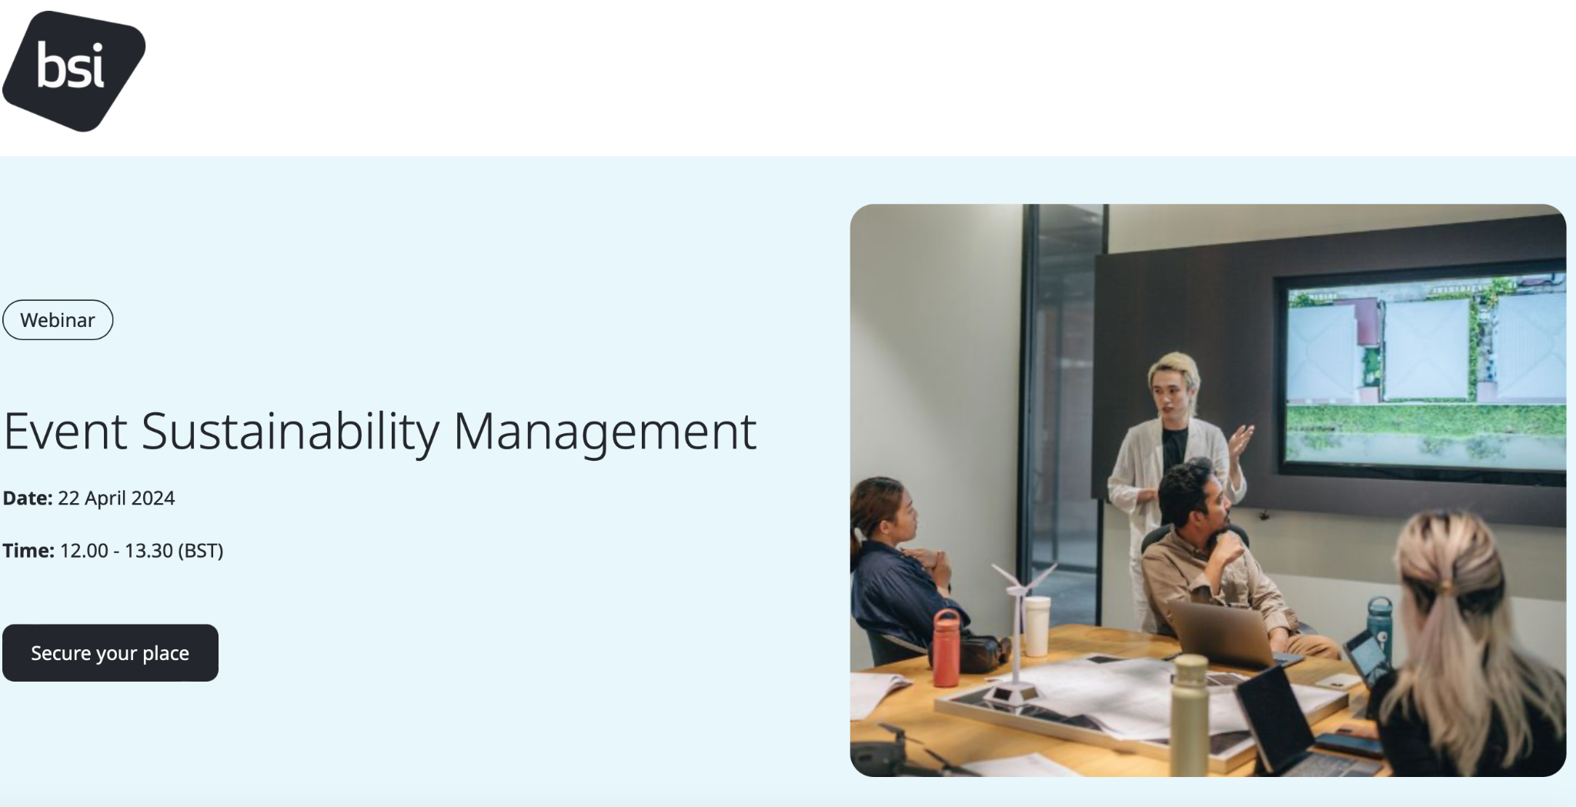
Click here to register
Notes:
To learn more about ISO 20121:2024 join the launch event on April 22nd (registration link https://pages.bsigroup.com/l/35972/2024-03-18/3t7mjr2?mc_cid=d31ef3f3a3&mc_eid=7cccb8bcf8&mc_cid=27161ea2b8&mc_eid=UNIQIDv)

Slide 11
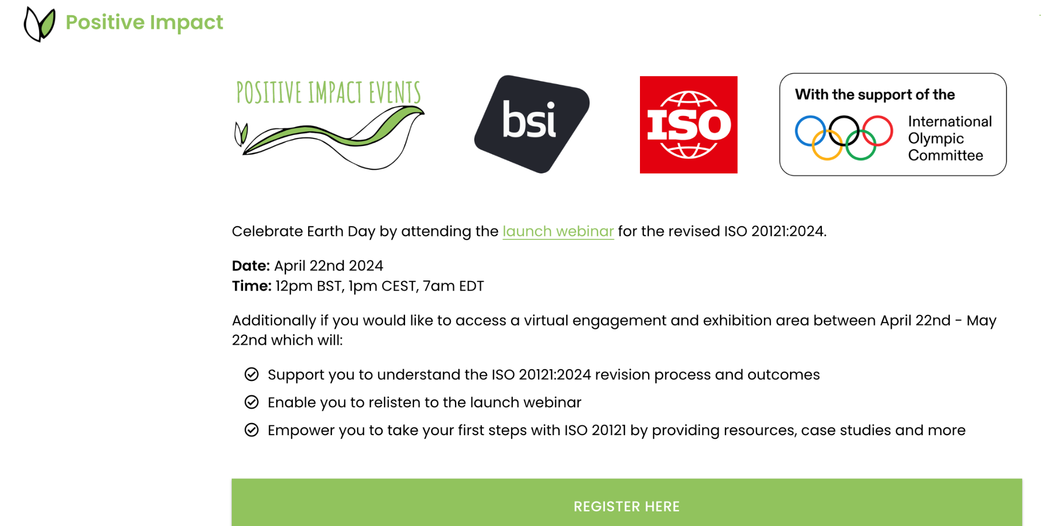
Click here to register
Notes:
Don't worry if you can not make the launch webinar because between April 22nd- May 22nd Positive Impact have curated a virtual engagement area with resources to help event professionals and Heads of Sustainability learn more about ISO 20121.
You can register here
https://www.positiveimpactevents.com/resources/iso-20121-2024-enabling-a-sustainable-event-industry?mc_cid=27161ea2b8&mc_eid=UNIQID

Slide 12
We hope this insight in to the revision of iso 2024 has insp u than you for being in action for the global event
© 2024 Positive Impact. These materials and all associated materials for ISO 20121 Implementation course are the property of Positive Impact Events. No modifications, modification or reuse in any form for any other purpose is allowed without written permission from Positive Impact Events.

