Slide 1
CELEBRATING WORLD ENVIRONMENT DAY:
2023
#eventscreatechange #pievents

Slide 2
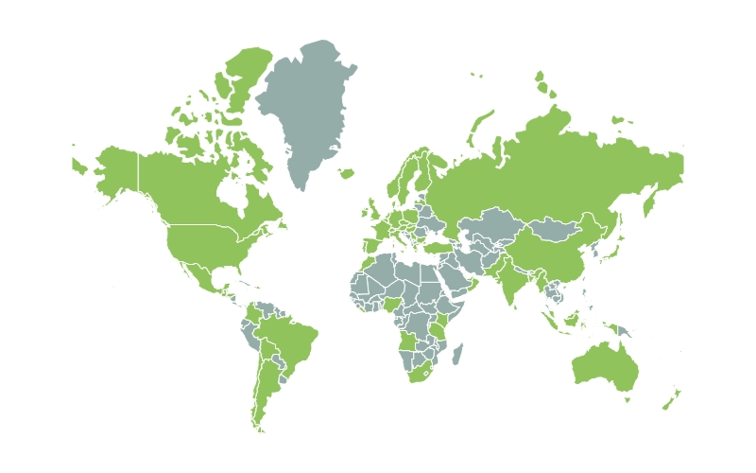
Using my Voice
As one of almost 2,000 Positive impact ambassadors around the world I am committed to using my voice to champion the creation of a sustainable event sector

Slide 4
The future of human
engagement is moving fast
What will your clients expect from you?
1- Credible standards
2- Credible actions
3- Best practice sharing without greenwash
.

Slide 5
Today’s presentation
1- ISO 20121
2- UNICEF UK human and child rights and safeguarding
3- Race to Zero Accelerator for events
4- Share a Positive Impact UN SDG Action Mobiliser campaign
5- Opportunities for your voice to be heard and extra support
.

Slide 6
ISO 20121 Animation
During 2023 ISO 20121, the only international standard for sustainability in events will be revised. There is the opportunity for the global event sector to be involved. This animation explains more.

Slide 7
How to Trial ISO 20121
Romain Riboud: paris 2024

Slide 8
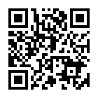
Trial ISO 20121
Use the QR code on this slide to access the toolkit –
How to trial ISO 20121

Slide 9
How to comment
on ISO 20121
Yann orhan: French National standards Association (afnor)

Slide 10
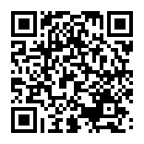
Comment
on ISO 20121
Use the QR code on this slide to access the toolkit –
Comment on ISO 20121

Slide 11
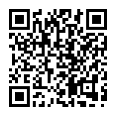
Case study
on ISO 20121
Watch this short video
on how to create a
case study
You can access the case study toolkit here

Slide 12
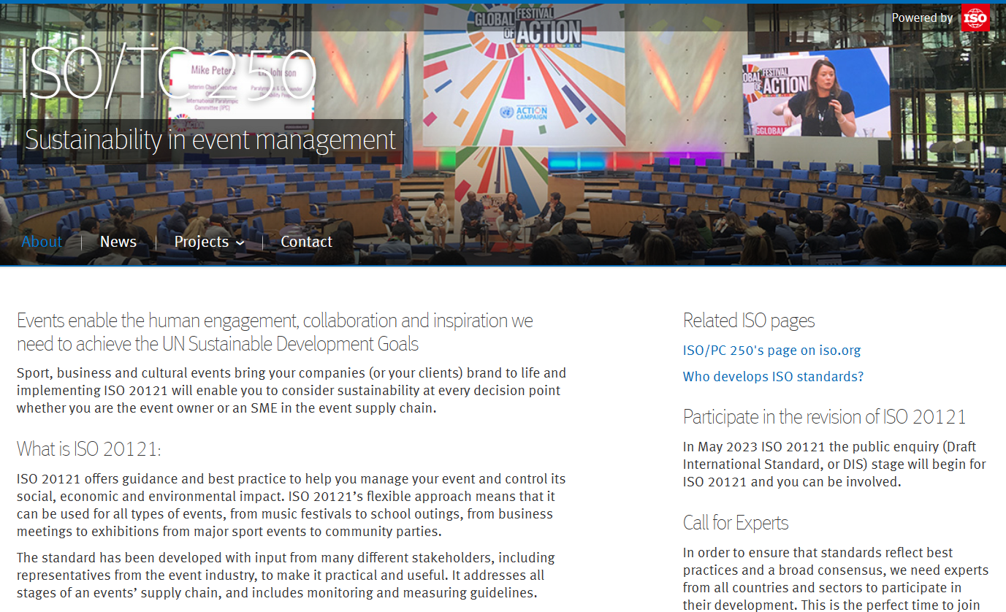
Iso 20121
Enquiry period
ISO 20121 is open for your public enquiry June 29th - Sept 19th
Contact your national standard body or liaison body to give your feedback
https://committee.iso.org/home/tc250

Slide 13
Human & Child Rights
ISO 20121 launched in 2012 inspired by the London Olympic and Paralympic Games. The revised ISO20121 is set to launch before the Paris 2024 Olympic and Paralympic Games. Sustainability and the expectations of event attendees has advanced since 2012 for example in the area of human and child rights and safeguarding, as this short animation explains.

Slide 14
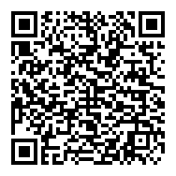
Human and child rights and safeguarding
Use the QR code on this slide to access the guidance –
Consideration of Human and child rights and safeguarding

Slide 15
Birmingham Commonwealth games
Judith Dix

Slide 16
Race to Zero

Slide 17
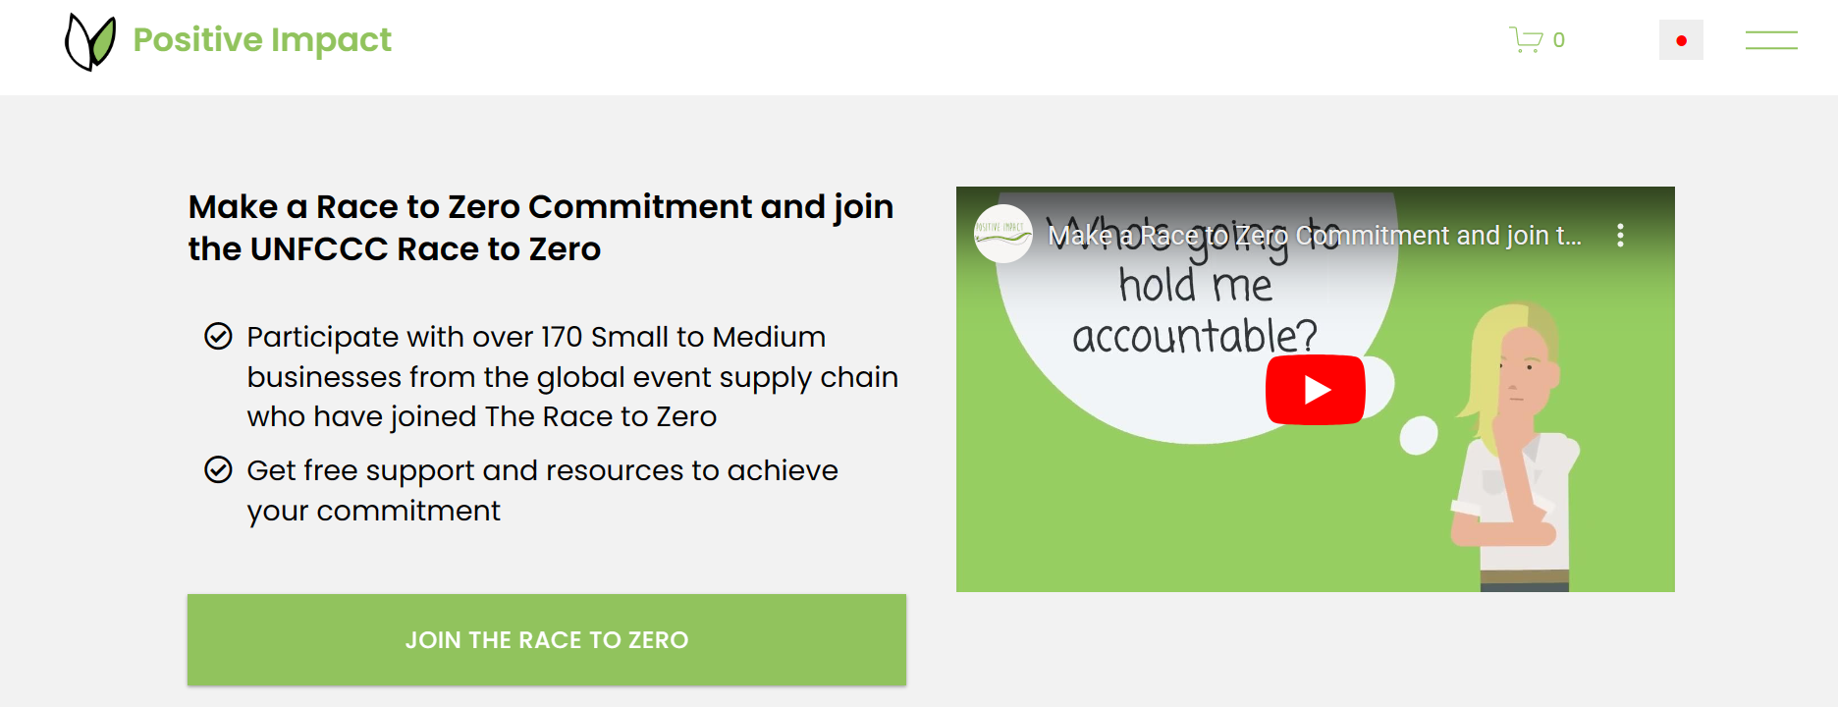
Race to Zero
On June 26th the Race to Zero report will include a section written by Positive Impact on the role of events in achieving the Race to Zero
Positive Impact | Education and collaboration for a sustainable event sector (positiveimpactevents.com)

Slide 18
Share a Positive Impact

Slide 19
Share a Positive Impact
The global community of over 1,800 Positive Impact Ambassadors have unique opportunities to contribute their voice to the creation of a sustainable event sector including:
Input into the ISO 20121 revision process
Input into the Positive Impact Acceleration Action Report which is submitted to UN Global Compact and UN SDG action. Here is our 2022 report
Take action on ISO 20121 trialling, commenting and creating a case study , human and child rights and safeguarding, Race to Zero

Slide 20
Your input
To help us shape the resources you need in the future, you can provide your feedback here

Slide 21
greenwashing
'conveying a false impression about how environmentally sound products and services and initiatives are'
The event sector is increasingly full of reports, initiatives, roadmaps, ranking systems and many lack credibility.
To understand if an initiative is credible ask the question:
If the initiative is about carbon, is it part of The Race to Zero?
Does the initiative align with ISO 20121?
Is there a UN link to the initiative?

Slide 22
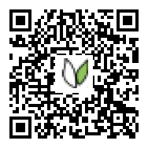
CPD
During 2023 Heads of sustainability, event professionals and any of the supply chain delivering engagement will need to build their capacity and knowledge in credible sustainability initiatives.
Positive Impact has launched a series of education resources which are certified by the world’s leading and largest CPD accreditation organisation working across all industry sectors.
This means Heads of Sustainability and Heads of Marketing can now gain continuing professional development hours through Positive Impact’s education. Use the QR code on this slide to access these credible education resources

Slide 23
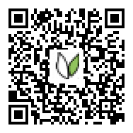
Become an Ambassador!
Use the QR code on this slide to register as a Positive Impact Ambassador!

Slide 24
Thank you for listening
@PIevents
@positiveimpact
www.positiveimpactevents.com

